Slide 1
public class Movie {
private int movieId;
private String title;
private String description;
private Date releaseDate;
private String movieFileUrl;
private List<Genre> genres;
private List<Cast> castList;
// Getters & Setters
}
public class User {
private int userId;
private String name;
private String email;
private String password;
private String profileImage;
private String status; // active/inactive
// Getters & Setters
}
public class Admin {
private int adminId;
private String name;
private String email;
private String password;
private String profileImage;
// Getters & Setters
}
public class Cast {
private int castId;
private String name;
private String nationality;
private dateOfBirth date;
// Getters & Setters
}
public class Director {
private int directorId;
private String name;
private String nationality;
private dateOfBirth date;
// Getters & Setters
}
public class SubscriptionPackage {
private int packageId;
private String name;
private double price;
private int durationDays; // e.g., 30 days
private String description;
// Getters & Setters
}
public class Genre {
private int genreId;
private String genreName;
// Getters & Setters
}

Slide 2
public class Subscription {
private int subscriptionId;
private int userId;
private int packageId;
private Date startDate;
private Date endDate;
private String status;
// Getters & Setters
}
public class Review {
private int reviewId;
private int userId;
private int movieId;
private String comment;
private int rating; // 1-5 stars
private Date reviewDate;
// Getters & Setters
}
public class Payment {
private int paymentId;
private int userId;
private int subscriptionId;
private double amount;
private String paymentMethod;
private Date paymentDate;
// Getters & Setters
}
public class Watchlist {
private int watchlistId;
private int userId;
private int movieId;
// Getters & Setters
}

Slide 3
Before

Slide 4
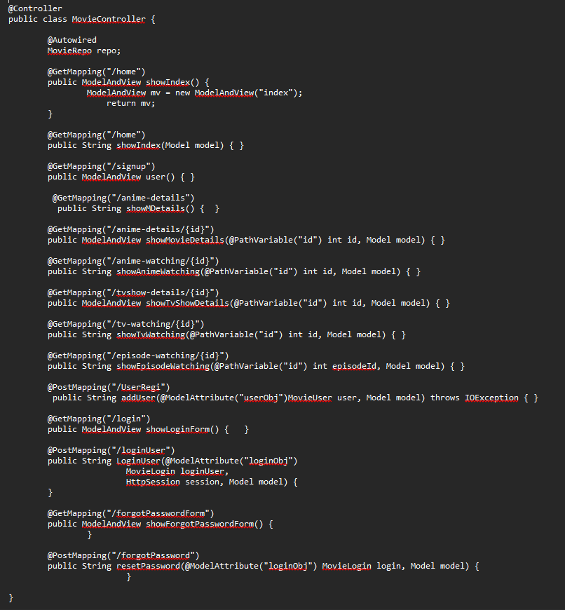

Slide 5
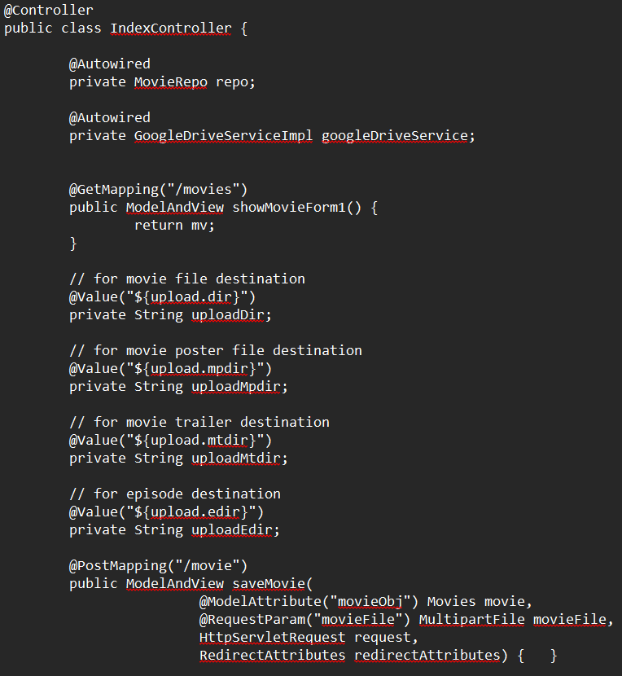

Slide 6
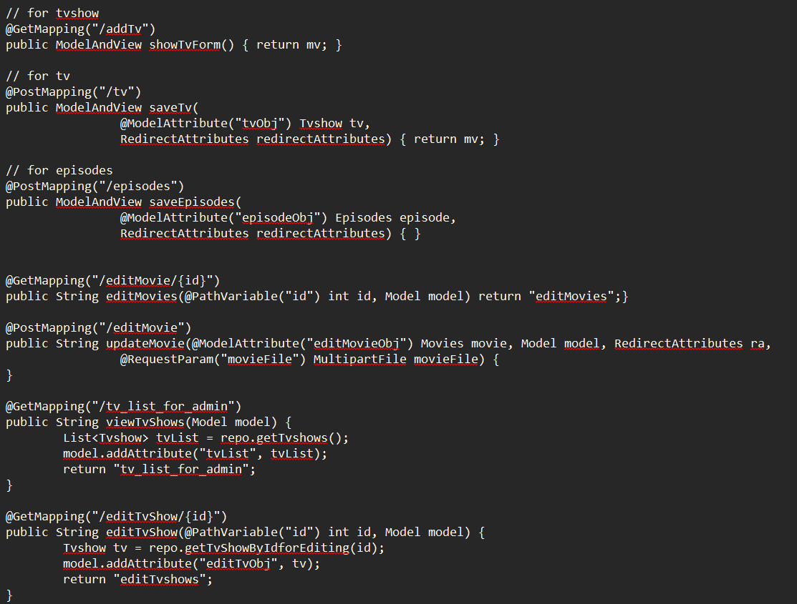

Slide 7
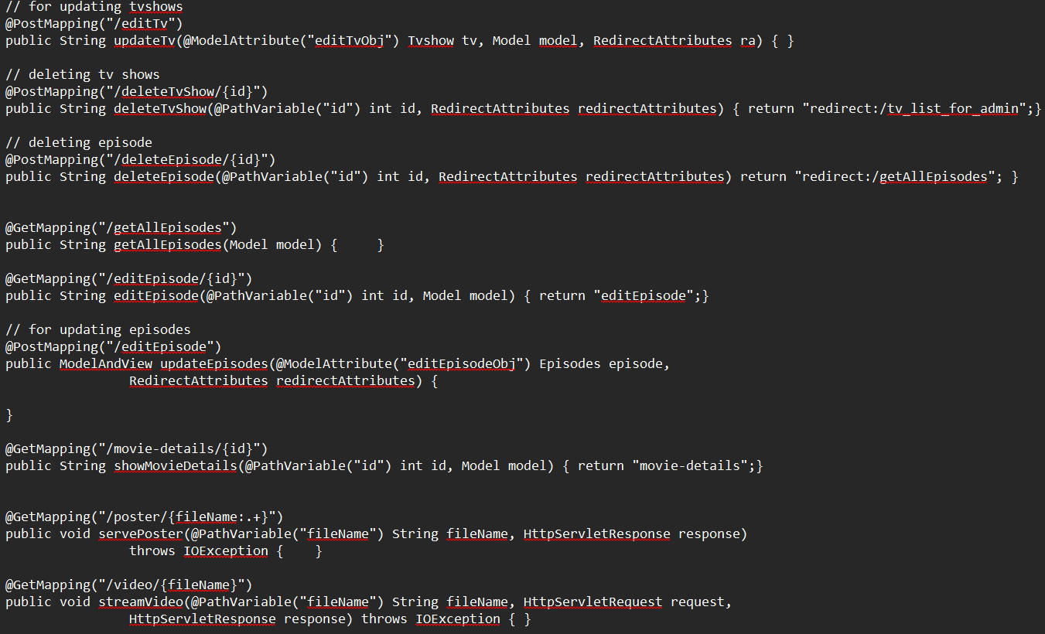

Slide 8
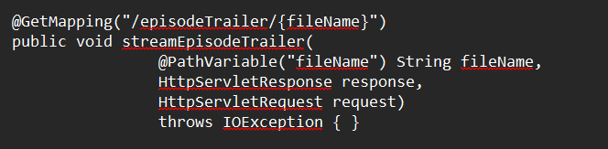

Slide 9
After

Slide 10
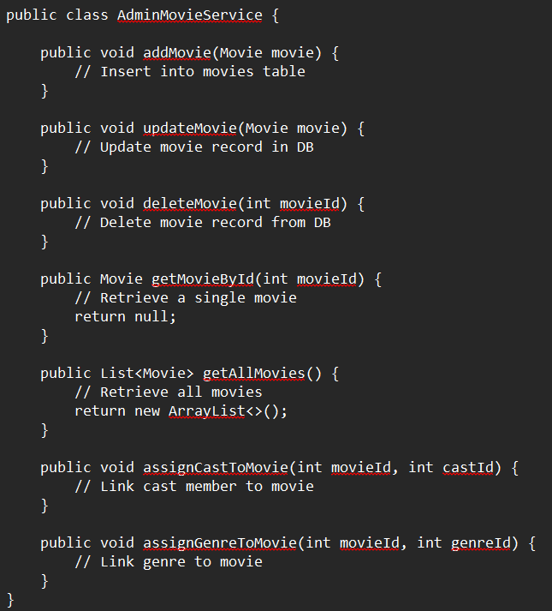
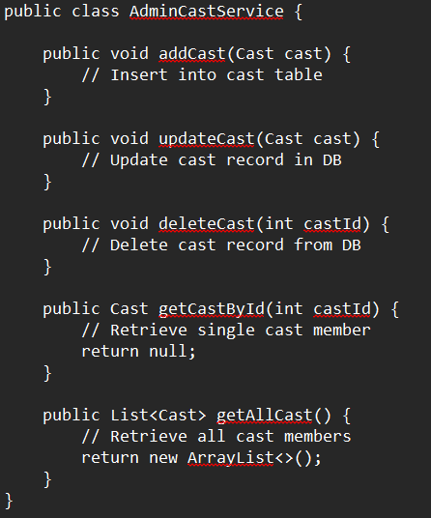

Slide 11
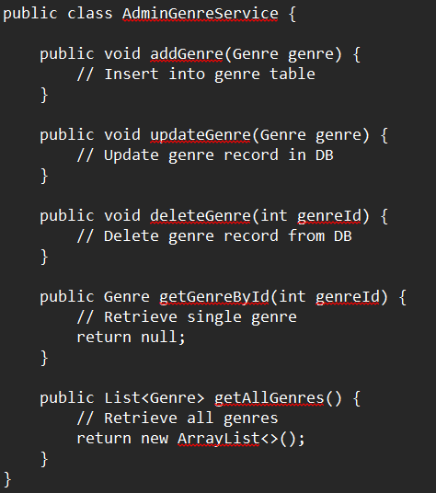
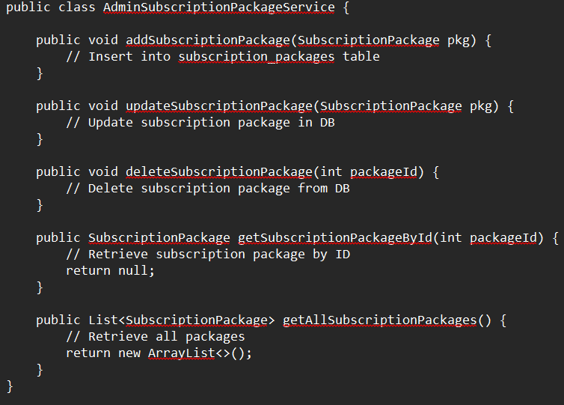

Slide 12
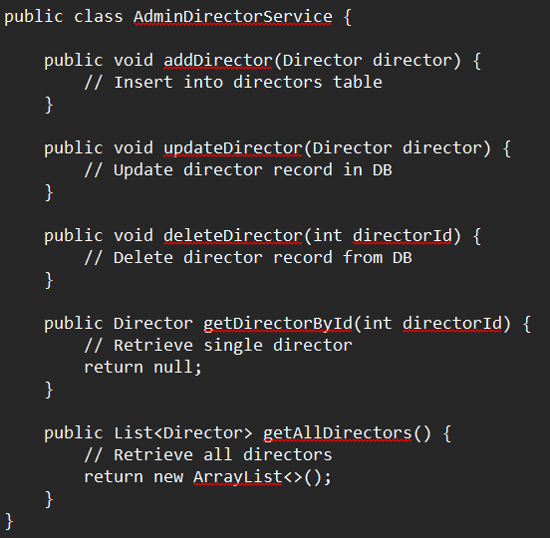
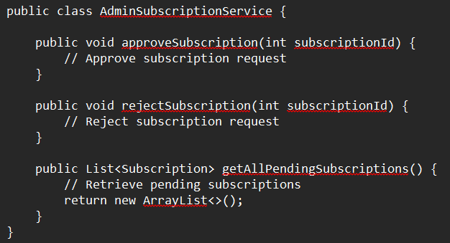

Slide 13
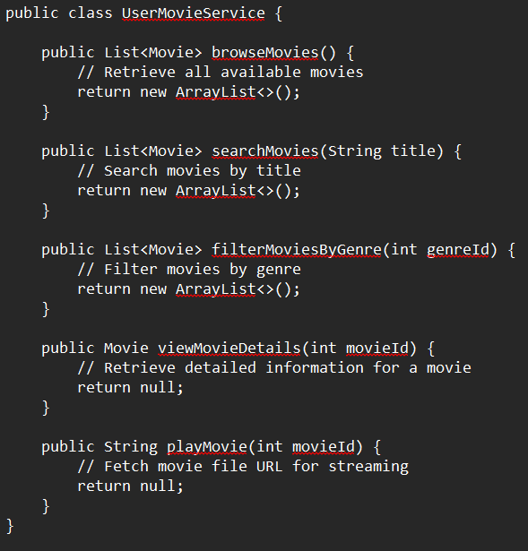
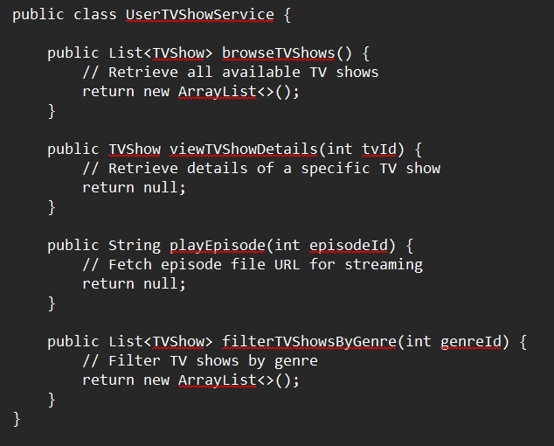

Slide 14
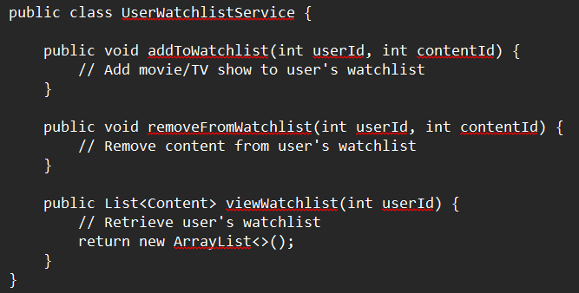
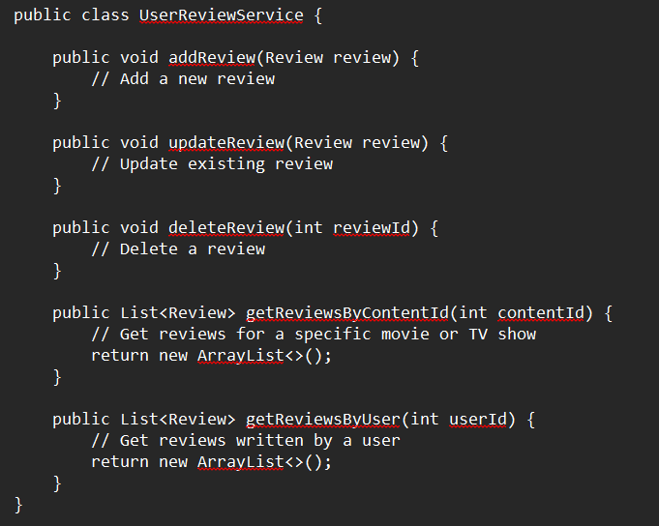

Slide 15
